Slide 1

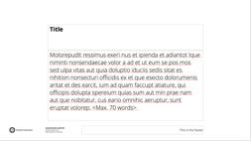

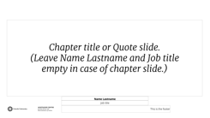


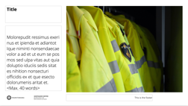


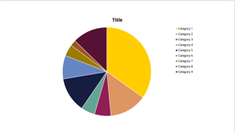




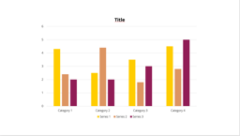

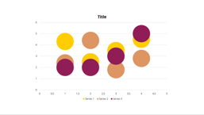
UU POWERPOINT TEMPLATE
OVERVIEW OF TYPE OF SLIDES
DELETE THIS SLIDE
EXCLUDE IT FROM YOUR PRESENTATION
1: Cover
2: Text
3: Full screen image
4: Chapter title/ quote slide
5: Blank
6: Disclaimer
You can add your own image to this slide. This document also includes some ready-made slides.
In three variants
In two variants.
In three variants.
For charts, formulas, etc.
Leave at the end.
To help you get started with charts, we added a few ready-made examples in this document. All you need to do is put in your own data.
Text only
Without caption
Text only
Without partner logos
Text left, image right
With caption
Text left, image right
With partner logos
Text right, image left
Text right, image left

Slide 2
INFOMR Shape Retrieval System
Jarno Hendriksen
Ge Li
October 2024

Slide 3
1
Overview
2
Preprocessing
3
Feature Extraction
4
Querying
5
Scalability
6
Demo

Slide 4
1
Overview
2
Preprocessing
3
Feature Extraction
4
Querying
5
Scalability
6
Demo

Slide 5
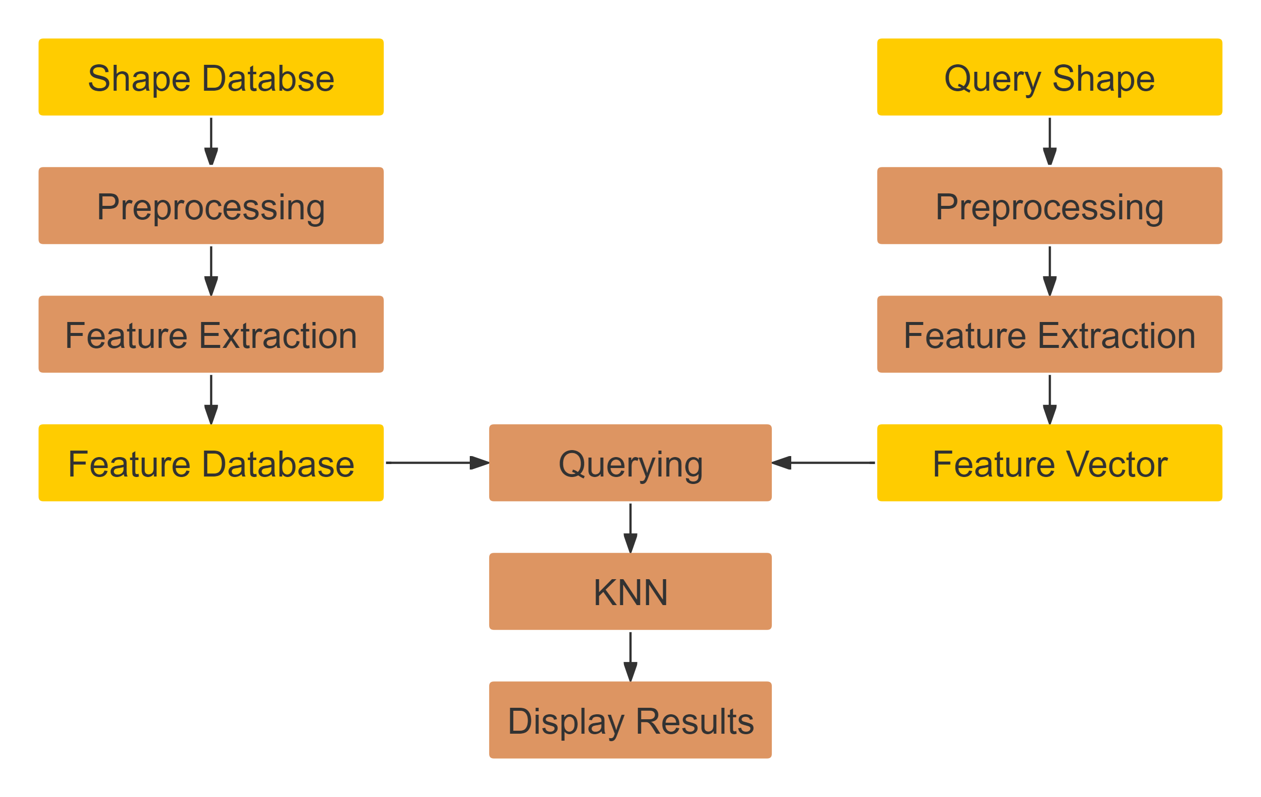
Overview

Slide 6
1
Overview
2
Preprocessing
3
Feature Extraction
4
Querying
5
Scalability
6
Demo

Slide 7
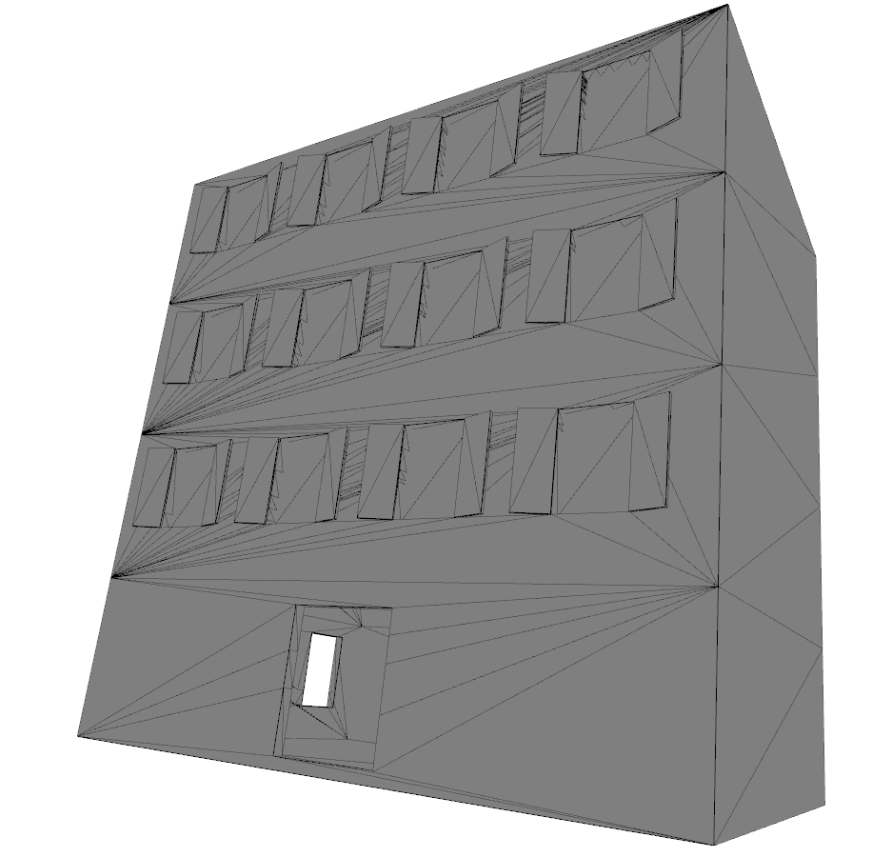
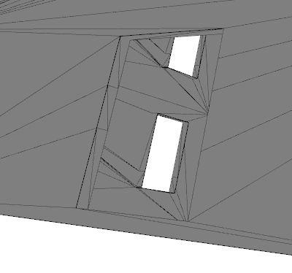
Preprocessing - Mesh fixing
D00792.obj from the class “Apartment”.

Slide 8
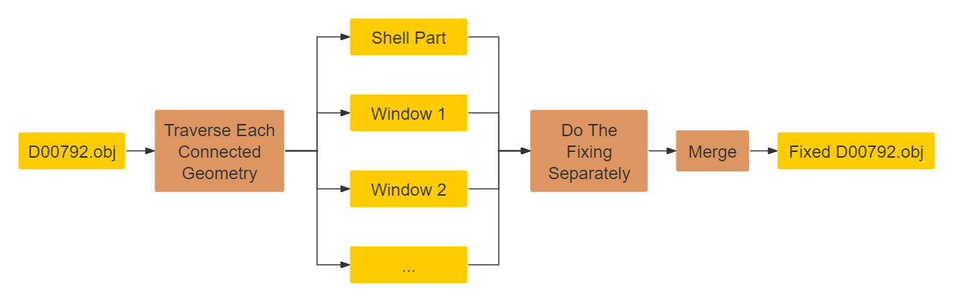
Preprocessing - Mesh fixing
Use “MeshFix” function from the “pymeshfix” package.

Slide 9
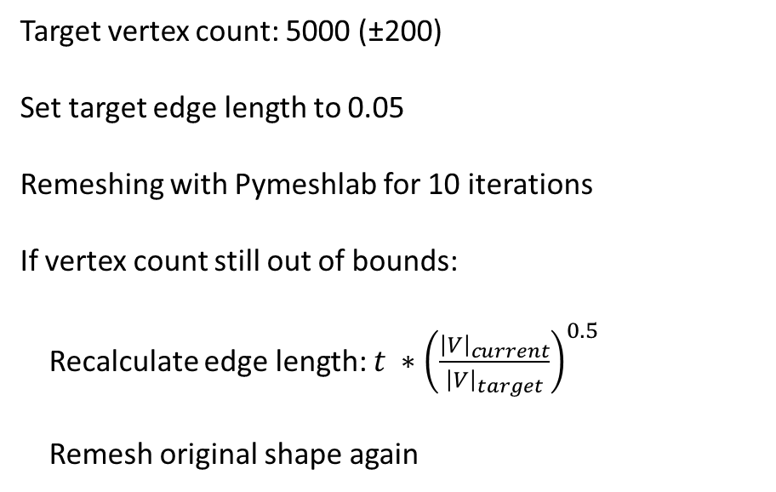
Preprocessing - Resampling
Target vertex count: 5000 (±200)
Set target edge length to 0.05
Remeshing with Pymeshlab for 10 iterations
If vertex count still out of bounds:
Recalculate edge length: $t ∗{\left(\frac{{\left|V\right|}_{current}}{{\left|V\right|}_{target}}\right)}^{0.5}$
Remesh original shape again

Slide 10
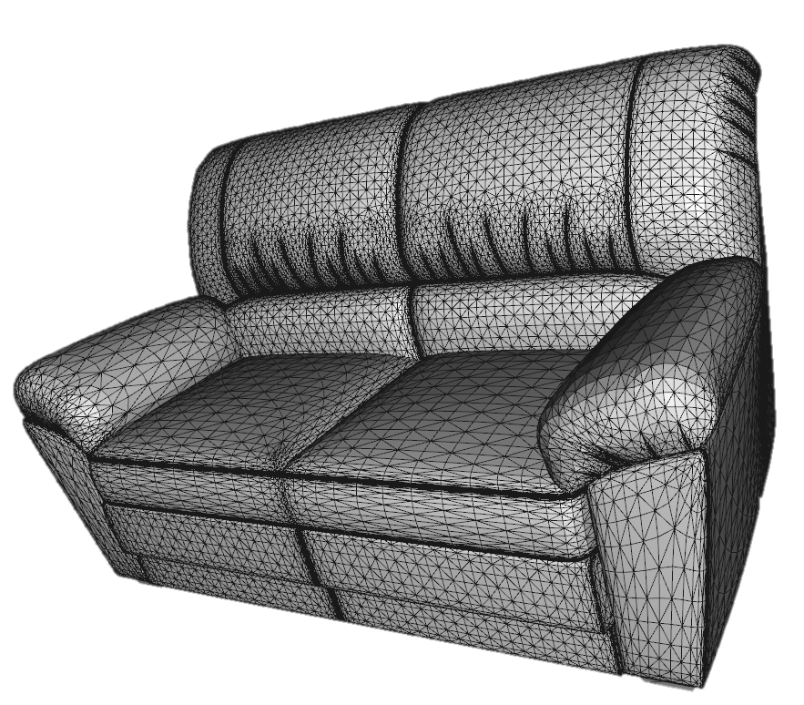
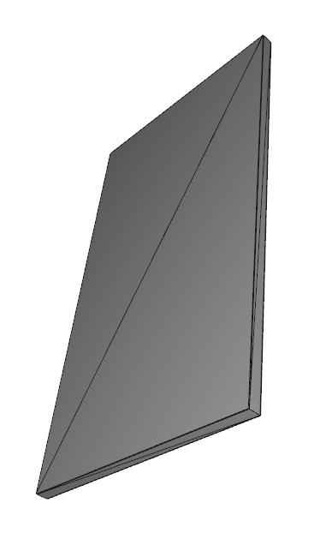
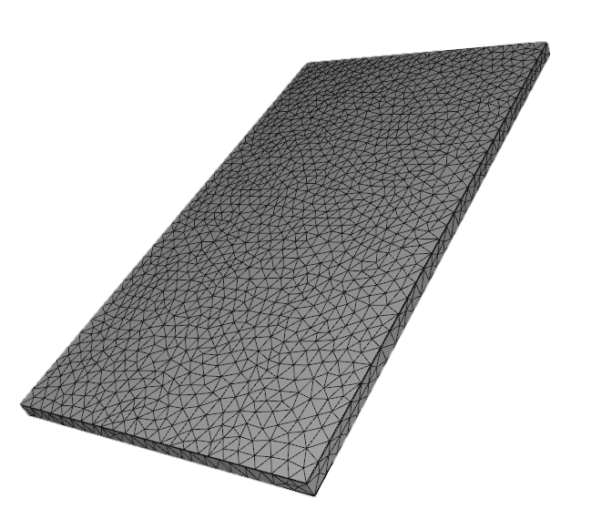
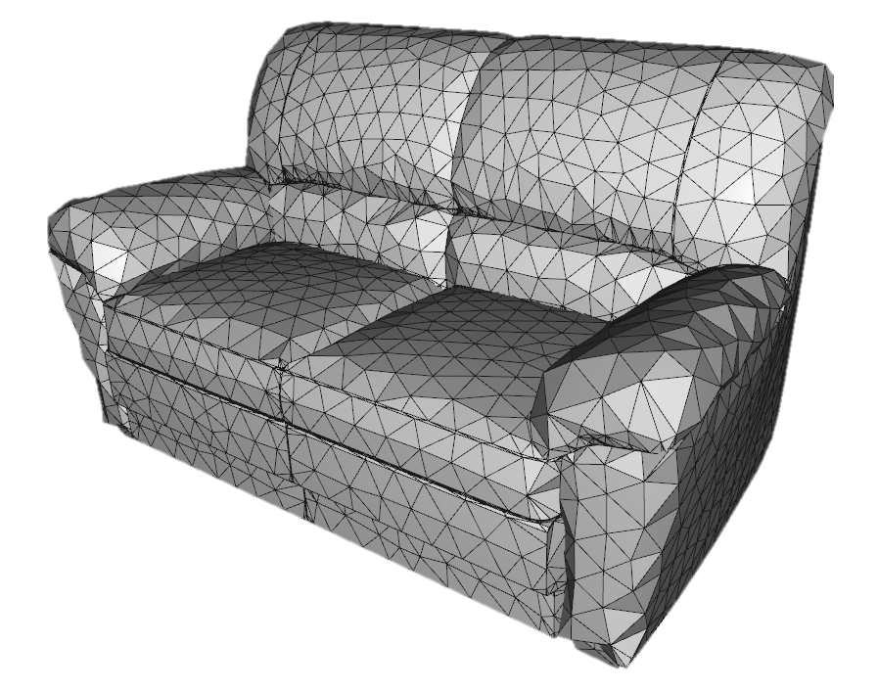
Preprocessing - Resampling

Slide 11
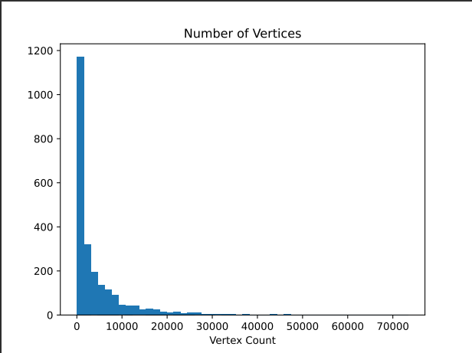
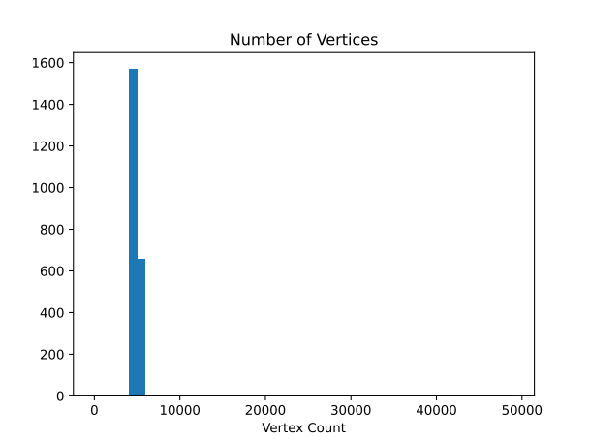
Preprocessing - Resampling

Slide 12
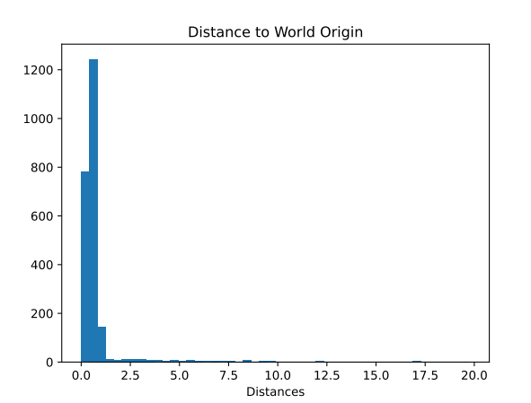
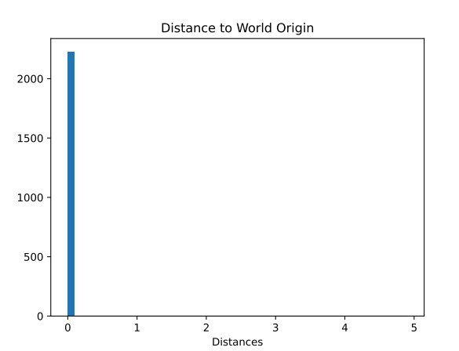
Preprocessing - Normalization - Translation

Slide 13
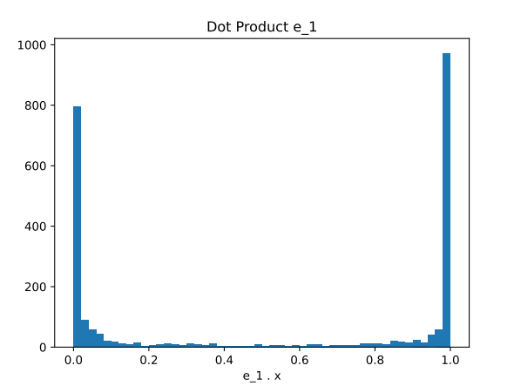
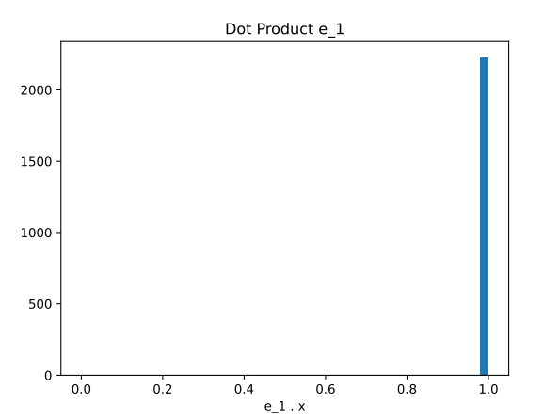
Preprocessing - Normalization - Rotation

Slide 14
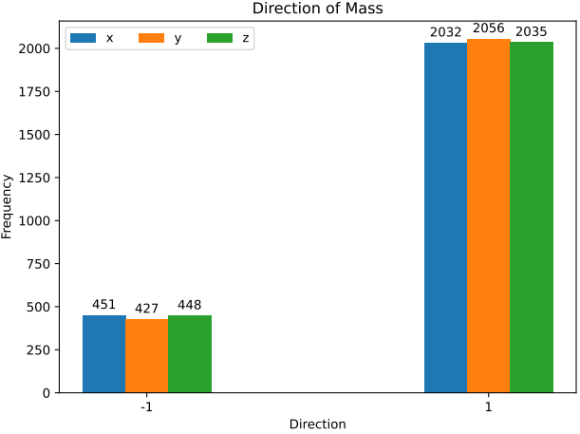
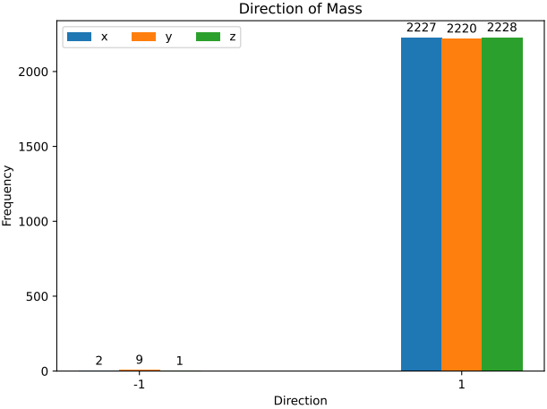
Preprocessing - Normalization – Orientation

Slide 15
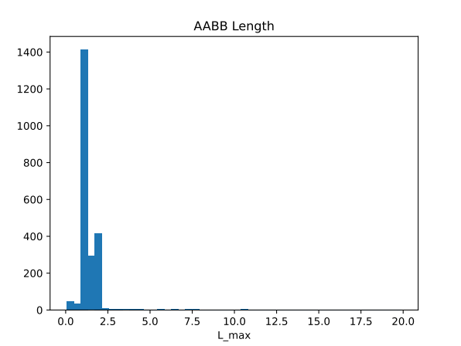
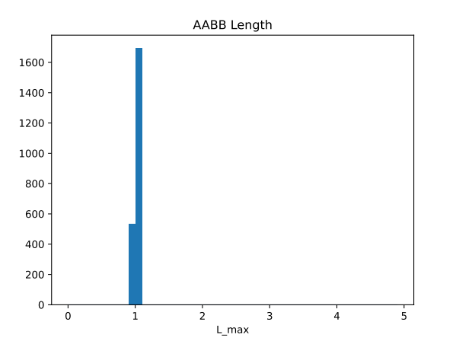
Preprocessing - Normalization - Scaling

Slide 16
1
Overview
2
Preprocessing
3
Feature Extraction
4
Querying
5
Scalability
6
Demo

Slide 17
1
Overview
2
Preprocessing
3
Feature Extraction
4
Querying
5
Scalability
6
Demo

Slide 18
1
Overview
2
Preprocessing
3
Feature Extraction
4
Querying
5
Scalability
6
Demo

Slide 19
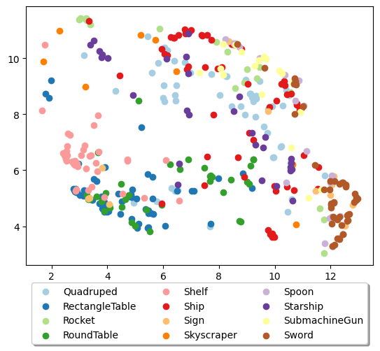
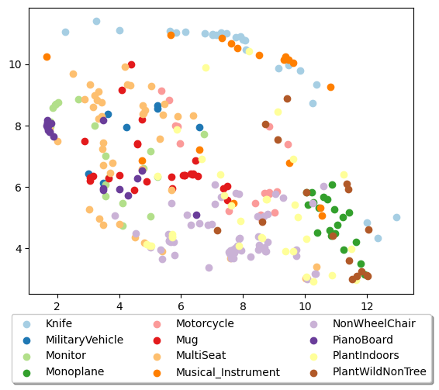
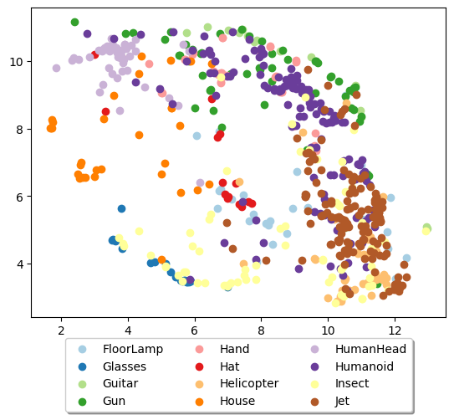
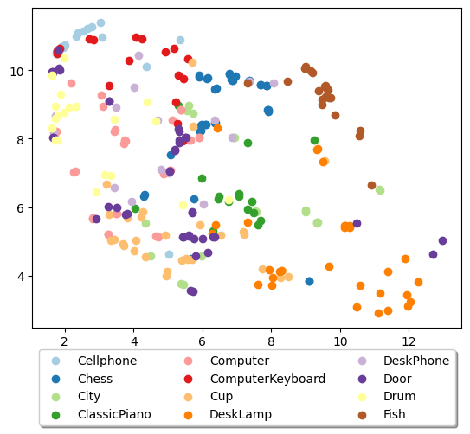
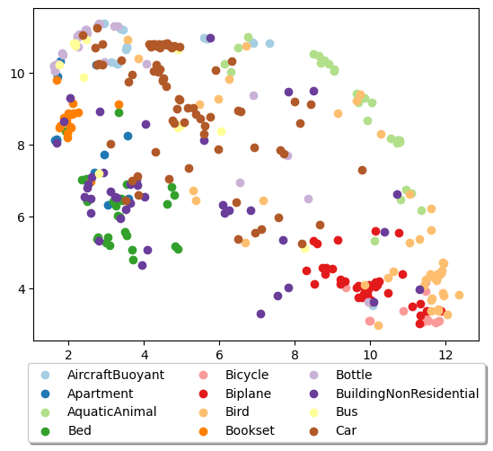
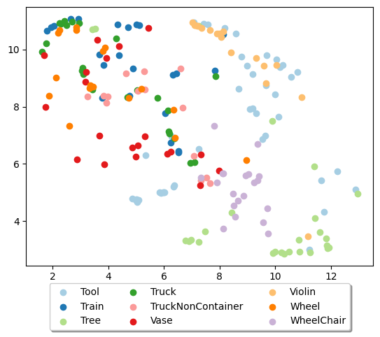
Scalability
1500 iterations
35 perplexity

Slide 20
1
Overview
2
Preprocessing
3
Feature Extraction
4
Querying
5
Scalability
6
Demo

